Slide 1
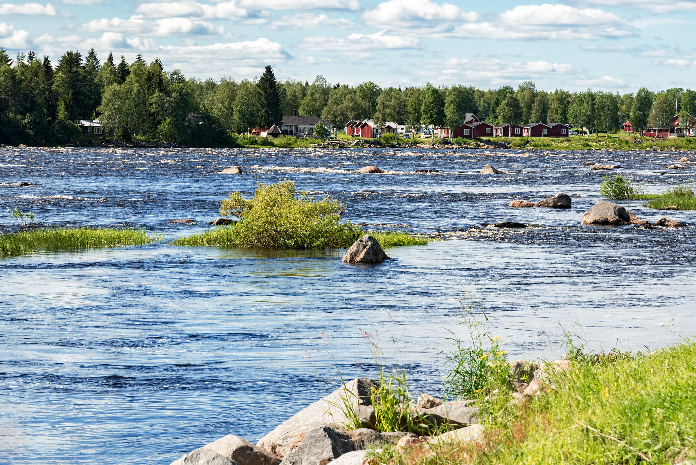
AELCLIC_PATHFINDER project
Tornio River_Pilot Landscape
AELCLIC_project
TORNIO RIVER_Pilot Landscape

Slide 2
AELCLIC_Pathfinder
Tornio River Valley_Pilot Landscape
The Tornio River Valley has been selected as one of the 16 European landscapes of the AELCLIC-Pathfinder project (Adaptation of European Landscapes to Climate Change) funded by EIT_Climate-KIC (EU).
WHY?: This decision was based on its location in the highly sensitive Boreal area, on its exceptional environmental and cultural values, on its transnational character and on the deep connection between local economy and natural landscape.
WHAT?: The AELCLIC-Pathfinder will create a local network (Consortium) for the future development of a Landscape Adaptation Plan to Climate Change (LACAP). This network or Consortium will be integrated by local authorities, civil organizations, economic actors (e.g. companies working with tourism, fishing, forestry, etc.) and academic/scientific institutions.
FINAL OUTCOME?: By the end of the AELCLIC_pathfinder project the Tornio River Valley will have:
A diagnosis of Climate Change impacts in the local economy, ways of living, environment, cultural heritage and levels of wellbeing. This diagnosis will be based in the CO-IDENTIFICATION of impacts by all the stakeholders on the base of existing national or regional reports and studies.
A CO-DEFINED document with the GOALS, STRUCTURE and MAIN CONTENTS that a future Landscape Adaptation Plan to Climate Change should have for the Tornio River Valley. This document will be agreed collectively by all the stakeholders.
A Joint LETTER of COMMITMENT in which all the members of the Local Network (Consortium) will express their willingness to advance in the future preparation of a local Landscape Adaptation Plan to Climate Change.
HOW?: The Tornio River Valley is included in the NORTHERN-EUROPE area of the AELCLIC-pathfinder. This area is coordinated by the Aalto University in collaboration with the Landscape Observatory of Finland. The participation of local stakeholders will not imply any economic duty. Basically they will be invited to participate in the organization of the following 3 workshops and to disseminate the project through their own channels.
WORKSHOP 1: (1 day, March-April 2019): After conforming the local network, the stakeholders will agree a work plan for the next sub-phases and workshops
WORKSHOP 2: (1 day, May-June 2019): Co-Identification by the local Consortium (stakeholders) of the potential impacts of Climate Change in their ways of living, economic activities, environmental and cultural assets
WORKSHOP 3: (1 day, July-September): Co-Definition of goals, agendas, contents and co-identification of potential economic resources for the future development of a LACAP (after the AELCLIC-pathfinder is finished)

Slide 3
AELCLIC_PATHFINDER_in a Nutshell
GENERAL DESCRIPTION
NEED: Climate-Change adaptation is highly site specific and requires the definition of frameworks and policies supporting, guiding and coordinating vertical and horizontal initiatives. These policies and initiatives are more effective and implementable when they are the result of the collaboration of social, governmental, economic, and academic partners. However, there is a need to advance in the creation of regional/local models to align agendas and visions of the different types of stakeholders involved in the management, adaptation and transformation of the landscape, both in rural and urban areas as well as in transitional spaces.
GOAL: The AELCLIC-PATHFINDER would define and test MODELS for the configuration of regional/local consortia with the social, financial, administrative and technical capacity to co-define Landscape Adaptation Plans to Climate Change (LACAPs hereafter). NOTE: A LACAP would include regional/local policies, strategies, pilot actions and initiatives to promote Climate Change adaptation and would be defined in a joint process between local and regional stakeholder.
OUTCOME: The final outcome of the AELCLIC-PATHFINDER would be a group of regional/local Consortia in a strategically selected set of European Pilot Landscapes that have been chosen in order to cover the climatic, socio-economic, cultural and biogeographical diversity of Europe and in order to produce highly transferable and scalable models.
USERS: The final users of the models and results will be firstly the regional/local communities where the Consortia will been defined as a result of the AELCLIC-PATHFINDER. They will be ready and will have the economic sustainability to move on to the definition of their own LACAPs. Secondly, other regions and municipalities will be able to benefit from the produced models and adapt them to their own conditions. In terms of type of users, the AELCLIC-PATHFINDER is mainly aimed at regional/local administrations, civil society groups and economic actors, whose work would be supported by academic-research institutions. This aim has guided the selection of partners and third parties in the AELCLIC-PATHFINDER project although the identification and involvement of local economic actors and civil society groups will be mainly implemented during the execution of the project.
METHOD: The AELCLIC-PATHFINDER project will include 4 tandems of Universities and Regional/Local Authorities (all CLIMATE-KIC Partners) promoting the development of regional/local Consortia in a set of Leading Pilot Landscapes. The models generated in those Leading Pilot Landscapes will afterwards be tested and adapted in a set of Multiplier Pilot Landscapes with the support of regional/local third parties. In addition, the participation of some European Networks as third parties (UNISCAPE and CIVILSCAPE) will facilitate a critical revision of the transferability/scalability of the models and will provide a wide platform for the dissemination of results and for the identification of potential new stakeholders in regional/local Consortia.

Slide 4
AELCLIC_PATHFINDER_in a Nutshell
STRUCTURE
5 WORK PACKAGES and 4 REGIONS:
WP1: coordination + Web + general dissemination
- Coordinator of the WP1: Aalto Univ.
WP2: implementation in NORTHERN EUROPE (1 Leading Pilot (District of Helsinki) + 3 Multiplier Pilots (Tornio river valley (FI-SE), Hyypänjoki cultural landscape (FI) and Tonder marshlands (DK))
- Coordinator of the WP2: Aalto Univ. / Partner for Helsinki: City of Helsinki / 3rd parties: Landscape Observatory of Finland). New governmental, social, economic and academic collaborators will be involved as part of the creation of local networks (Consortia) in the Pilot Landscapes
WP3: implementation in ATLANTIC AND ALPINE EUROPE (1 Leading Pilot (Lowland peat and polder landscape of Holland (NL)) + 3 Multiplier Pilots (Bertra beach dune system, county Mayo (IR), Mer de Glace and alpine glaciers (FR), Mount Saint Michel (FR))
- Coordinator of the WP3: Wageningen University/ Partner for the Netherlands: Provincie Zuid-Holland / 3rd parties: National University of Ireland-Galway (for IR), Landscape Observatory of the Netherlands. New governmental, social, economic and academic collaborators will be involved as part of the creation of local networks (Consortia) in the Pilot Landscapes
WP4: implementation in SOUTH-WESTERN EUROPE (1 Leading Pilot (Pilot area of the Huerta de Valencia) + 3 Multiplier Pilots (ES, PT))
- Coordinator of the WP4: Polytechnic Univ. of Valencia/ Partner for the Huerta de Valencia: LASNAVES (City of Valencia) / 3rd parties: Landscapes Observatories of Catalonia and the Canary Islands (for ES), University of Porto (for PT). New governmental, social, economic and academic collaborators will be involved as part of the creation of local networks (Consortia) in the Pilot Landscapes
WP5: implementation in SOUTH-EASTERN EUROPE (1 Leading Pilot (Urban Fringe areas of Bologna) + 3 Multiplier Pilots (IT, RO))
- Coordinator of the WP5: University of Bologna / Partners for the Fringe areas of Bologna: Comune di Bologna, Fondazione per l’Innovazione Urbana / 3rd parties: EURODITE (for RO), Piante Faro and IUAV (for IT). New governmental, social, economic and academic collaborators will be involved as part of the creation of local networks (Consortia) in the Pilot Landscapes

Slide 5
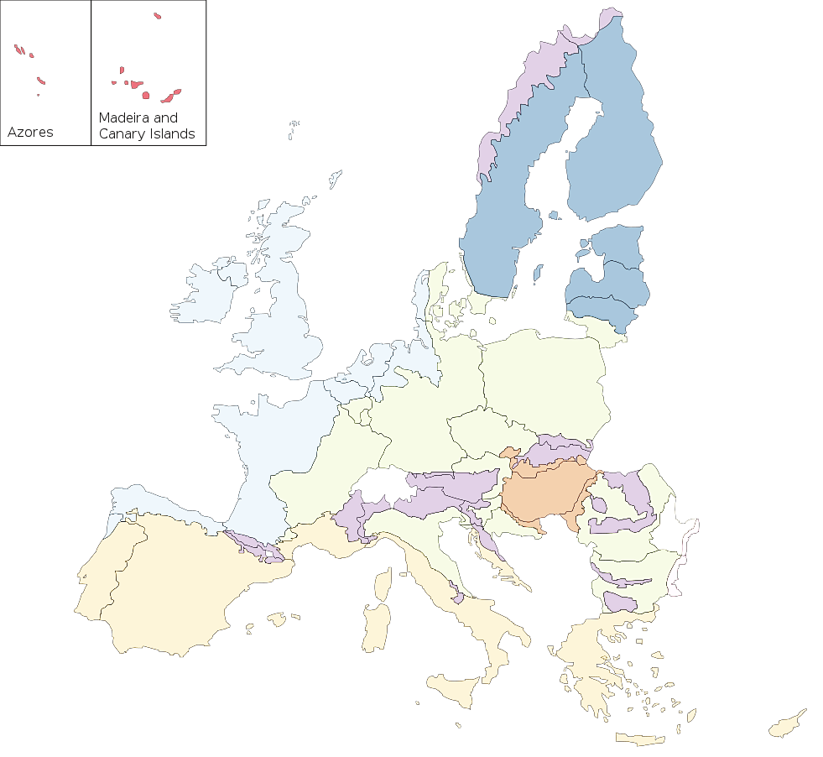
EUROPEAN NETWORKS
UNISCAPE (UNIVERSITIES)
CIVILSCAPE (CIVIL SOCIETY ORGANIZATIONS (NGOs)
AELCLIC PATHFINDER (Partners & Third parties)
AELCLIC partners
Academic
Regions / Cities
NGOS
Business
AELCLIC third parties
Academic
Regions / Cities
NGOS
Business
AELCLIC Leading Pilot Landscapes
AELCLIC Multiplier Pilot Landscapes
MULTIPLIER PILOT LANDSCAPE: TORNIO RIVER VALLEY (FI-SE))
REGIONAL THIRD PARTY: LANDSCAPE OBSERVATORY OF FINLAND
MULTIPLIER PILOT LANDSCAPE: HYYPÄNJOKI CULTURAL LANDSCAPE (FI)
REGIONAL THIRD PARTY: LANDSCAPE OBSERVATORY OF FINLAND
PARTNERS: AALTO UNIVERSITY + CITY OF HELSINKI
LEADING PILOT LANDSCAPE: SITE IN THE METROPOLITAN AREA OF HELSINKI (PIHLAJAMÄKI DISTRICT)
MULTIPLIER PILOT LANDSCAPE: BERTRA BEACH DUNE SYSTEM, COUNTY MAYO (IR)
REGIONAL THIRD PARTY: NATIONAL UNIVERSITY OF IRELAND-GALWAY
MULTIPLIER PILOT LANDSCAPE: TONDER MARSHLANDS (DK)
PARTNERS: WAGENINGEN UNIVERSITY + PROVINCE OF ZUID-HOLLAND
LEADING PILOT LANDSCAPE: LOWLAND PEAT AND POLDER LANDSCAPE OF HOLLAND
REGIONAL THIRD PARTNER: LANDSCAPE OBSERVATORY OF THE NETHERLANDS
MULTIPLIER PILOT LANDSCAPE: MOUNT SAINT MICHEL (FR)
MULTIPLIER PILOT LANDSCAPE: MER DE GLACE AND ALPINE GLACIERS (FR)
MULTIPLIER PILOT LANDSCAPE: VILA DO CONDE COASTAL LANDSCAPE (PT)).
REGIONAL THIRD PARTY: UNIVERSITY OF PORTO
MULTIPLIER PILOT LANDSCAPE: TOWN AND VALLEY OF IVREA(IT))
REGIONAL THIRD PARTY: UNIVERSITÀ IUAV DI VENEZIA
MULTIPLIER PILOT LANDSCAPE: URBAN FRINGE BUCHAREST
REGIONAL THIRD PARTY: EURODITE_BUCHAREST (RO)
MULTIPLIER PILOT LANDSCAPE: PRIORAT or PENEDES REGION (ES)
REGIONAL THIRD PARTY: LANDSCAPE OBSERVATORY OF CATALONIA
PARTNERS: UNIVERSITY OF BOLOGNA + CITY OF BOLOGNA + FONDAZIONE PER L’INNOVAZIONE URBANA
LEADING PILOT LANDSCAPE: FRINGE AREAS OF BOLOGNA
MULTIPLIER PILOT LANDSCAPE: TOURISTIC ZONES OF NORTHERN TENERIFE (ES)
REGIONAL THIRD PARTY: LANDSCAPE OBSERVATORY OF CANARIAS
PARTNERS: POLYTECHNIC UNIV VALENCIA + LAS NAVES (CITY OF VALENCIA)
LEADING PILOT LANDSCAPE: HUERTA DE VALENCIA (ES)
MULTIPLIER PILOT LANDSCAPE: AGRICULTURAL LANDSCAPES IN THE SICILY REGION (IT)
REGIONAL THIRD PARTY: PIANTE FARO

Slide 6
AELCLIC PATHFINDER_WORK PACKAGES & BUDGET (+ Partners and Pilot Landscapes)
WP1: Coordination
RESPONSIBLE: Aalto University
TASKS: Coordination, General Dissemination and Web of the Project
BUDGET: 3,500 € + 25% Co-funded by Aalto University (875 €) = 4,375 €
THIRD PARTIES:
UNISCAPE (EU)
CIVILSCAPE (EU)
WP2: Implementation Northern Europe
RESPONSIBLE: Aalto University
TASKS: Definition of models and Consortia in the Finnish, Danish (and Swedish) Pilot Landscapes.
BUDGET: 25,500 € + 25% Co-funded by Aalto University (6,375 €) = 31,875 €
WP3: Implementation Atlantic-Alpine Europe
RESPONSIBLE: Wageningen University
TASKS: Definition of models and Consortia in the Dutch, Irish and French Pilot Landscapes.
BUDGET: 29,500 € + 25% Co-funded by University of Wageningen (7,375 €) = 36,875 €
WP4: Implementation South-Western Europe
RESPONSIBLE: Polytechnic University of Valencia
TASKS: Definition of models and Consortia in the Spanish and Portuguese Pilot Landscapes.
BUDGET: 16,000 € + 25% Co-funded by Polytechnic University of Valencia (4,000 €) = 20,000 €
WP5: Implementation South-Eastern Europe
RESPONSIBLE: University of Bologna
TASKS: Definition of models and Consortia in the Italian and Romanian
BUDGET: 17,500 € + 25% Co-funded by University of Bologna (4,375 €) = 21,875 €
BUDGET_2: Collaboration in the Pihlajamäki District? Pilot Landscape (Helsinki, FI)
RESPONSIBLE: City of Helsinki
TASKS: Collaboration in the definition of a Consortium for the Helsinki Pilot Landscape (Pihlamäki District)
BUDGET: Managed by Aalto University
BUDGET_3: Collaboration in the: Lowland Peat and Polder Landscape of Holland (NL)
RESPONSIBLE: Province of Zuid-Holland
TASKS: Collaboration in the definition of a Consortium for the ” Lowland Peat and Polder Landscape of Holland” Pilot Landscape.
BUDGET: Managed by Wageningen University
BUDGET_4: Collaboration in the Huerta de Valencia Pilot Landscape (ES)
RESPONSIBLE: Las Naves-City of Valencia
TASKS: Collaboration in the definition of a Consortium the Huerta de Valencia Pilot Landscape
BUDGET: 4,000 € + 25% Co-funded by Las Naves-City of Valencia (1000 €) = 5,000 €
BUDGET_5: Collaboration in the ”Fringe Areas of Bologna” Pilot Landscape (IT)
RESPONSIBLE: Fondazione per l’Innovazione Urbana
TASKS: Collaboration in the definition of a Consortium for the ”Fringe Areas of Bologna” Pilot Landscape
BUDGET: 4,000 € + 25% Co-funded by Fondazione per l’Innovazione Urbana (1000 €) = 5,000 €
THIRD PARTIES:
Landscape Observatory of Finland (FI)
New third parties will join during the constitution of local networks/consortia in the Pilot Landscapes
PILOT LANDSCAPES:
Leading Pilot Landscape: Pihlajamäki District (Helsinki, FI)
Multiplier Pilot landscapes:
TORNIO RIVER VALLEY (FI-SE)
HYYPÄNJOKI CULTURAL LANDSCAPE (FI)
TONDER MARSHLANDS (DK)
THIRD PARTIES:
National University of Ireland-Galway (IR)
Landscape Observatory of the Netherlands (NL)
New third parties will join during the constitution of local networks/consortia in the Pilot Landscapes
PILOT LANDSCAPES:
Leading Pilot Landscape: Lowland Peat and Polder Landscape of Holland (NL)
Multiplier Pilot landscapes:
BERTRA BEACH DUNE SYSTEM, COUNTY MAYO (IR)
MER DE GLACE AND ALPINE GLACIERS (FR)
MOUNT SAINT MICHEL (FR)
THIRD PARTIES:
Landscape Observatory of Catalonia (ES)
Landscape Observatory of the Canary Islands (ES)
University of Porto (PT)
New third parties will join during the constitution of local networks/consortia in the Pilot Landscapes
PILOT LANDSCAPES:
Leading Pilot Landscape: Huerta de Valencia (ES)
Multiplier Pilot landscapes:
PRIORAT or PENEDES REGION (ES)
TOURISTIC ZONES OF NORTHERN TENERIFE (ES)
VILA DO CONDE COASTAL LANDSCAPE (PT))
THIRD PARTIES:
Università IUAV di Venezia (IT)
Eurodite (SME) (RO)
Piante Faro (IT)
New third parties will join during the constitution of local networks/consortia in the Pilot Landscapes
PILOT LANDSCAPES:
Leading Pilot Landscape: Fringe Areas of Bologna (IT)
Multiplier Pilot landscapes:
URBAN FRINGE AREAS OF BUCHAREST (RO)
TOWN AND VALLEY OF IVREA (IT)
AGRICULTURAL LANDSCAPES IN THE SICILY REGION (IT)

Slide 7
AELCLIC PATHFINDER_METHODS AND SCHEDULE
15th FEBRUARY Kick-off
15 MARCH
15 APRIL
15 MAY
15 JUNE
15 JULY
15 AUGUST
15 SEPTEMBER
15 OCTOBER
15 NOVEMBER
15 DECEMBER
END
PHASE 2
PHASE 1
PHASE 3
PREPARATION
CREATION OF REGIONAL/LOCAL CONSORTIA AND CO-DEFINITION OF STRUCTURE, METHODS AND RESOURCES FOR THE PRODUCTION OF A LACAP
FINAL OUTPUTS & REPORTING
Sub-Phase 2.1
Sub-Phase 2.2
Sub-Phase 2.3 2.1
IDENTIFICATION OF STAKEHOLDERS IN EACH PILOT AREA + DEFINITION OF WORKING PLAN
JOINT WORK OF EACH LOCAL GROUP: DEFINITION OF CLIMATE CHANGE IMPACTS, GOALS, AGENDAS, STRUCTURE & RESOURCES FOR A LACAP
REGIONAL/LOCAL OUTPUTS & AGREEMENTS
IMPLEMENTATION OF THE PROJECT (WP1, 2, 3, 4, 5)
PO_x Partial OUTPUT in LEADING PILOT / in MULTIPLIER PLOT
PD_x Partial DELIVERABLE in LEADING PILOT/ in MULTIPLIER PILOT
FO_y Final OUTPUT
FD_y Final DELIVERABLE
Partial outputs/deliverables:
(X = 1): Consortium and Working Plan for each Pilot Landscape
(X = 2): Draft Structure and Implementation Plan for a LACAP (per Consortium & Pilot)
(X= 3): Final Structure and Implementation Plan for a LACAP (per Consortium & Pilot)
Final outputs/deliverables:
(Y = 1): Compilation of Final Partial Outputs / Deliverables
(Y = 2): New outputs and deliverables produced after the joint and critical analysis of the final results in each Pilot Landscape
(Y = 3): Guidelines for the constitutions of regional/local Consortiums
(Y = 4) Climate-KIC REPORTS (Performance report, financial report, etc.)
(Y = 5): web with all the deliverables
NOTE_ All the deliverables will be displayed in the web and disseminated by the partners
IDENTIFICATION OF STAKEHOLDERS IN EACH PILOT AREA + DEFINITION OF WORKING PLAN
per REGION (WP2, WP3, WP4, WP5)
JOINT WORK OF EACH REGIONAL/LOCAL GROUP: GOALS, AGENDAS, STRUCTURE, RESOURCES FOR A POTENTIAL LACAP
per REGION (WP2, WP3, WP4, WP5)
REGIONAL/LOCAL OUTPUTS & AGREEMENTS
per (WP2, WP3, WP4, WP5)
PREPARATION
FINAL OUTPUTS & REPORTING
PART 2.1.1. IDENTIFYING & CONTACTING
PART 2.1.2 AGREEING A WORK PLAN
PART 2.2.1 Climate Change:
DIAGNOSIS
PART 2.2.2. Climate Change Adaptation:
AGREEING THE KEY CONTENTS FOR A LACAP
2.3. Proposal for a local LACAP & AGREEMENTS
LEADING PILOT LANDSCAPE
LEADING PILOT LANDSCAPE
LEADING PILOT
Compilation of Final Partial Outputs / Deliverables
New outputs and deliverables produced after the joint and critical analysis of the final results Guidelines for the constitutions of regional/local Consortiums
Climate-KIC REPORTS
WP1: web + channels
By the responsible of WP2, WP3, WP4, WP5, BU2, BU3, BU4, BU5:
Self organization of each team.
Limits of each pilot landscape
Pre-identification of stakeholders for each regional /local consortia
PO_1/PD_1
PO_2/PD_2
PO_3/PD_3
2.1.1
2.1.2
2.2.1
2.2.2
2.3
MULTIPLIER PILOT LANDSCAPES
MULTIPLIER PILOT LANDSCAPES
MULTIPLIER PILOT
x
FO_1 / FD_1
x
FO_2 / FD_2
FO_3 / FD_3
PO_1/PD_1
For each Pilot
PO_2/PD_2
For each Pilot
PO_3/PD_3
For each Pilot
FD_4
FD_5

Slide 8
AELCLIC PATHFINDER_METHODS AND SCHEDULE
15n FEBRUARY Kick-off
15 MARCH
15 APRIL
15 MAY
15 JUNE
15 JULY
15 AUGUST
15 SEPTEMBER
15 OCTOBER
15 NOVEMBER
15 DECEMBER
END
PHASE 2
PHASE 1
PHASE 3
PREPARATION
CREATION OF REGIONAL/LOCAL CONSORTIA AND CO-DEFINITION OF STRUCTURE, METHODS AND RESOURCES FOR THE PRODUCTION OF A LACAP
FINAL OUTPUTS & REPORTING
Sub-Phase 2.1
Sub-Phase 2.2
Sub-Phase 2.3 2.1
IDENTIFICATION OF STAKEHOLDERS IN EACH PILOT AREA + DEFINITION OF WORKING PLAN
JOINT WORK OF EACH LOCAL GROUP: DEFINITION OF CLIMATE CHANGE IMPACTS, GOALS, AGENDAS, STRUCTURE & RESOURCES FOR A LACAP
REGIONAL/LOCAL OUTPUTS & AGREEMENTS
PHASE 1_preparation (15.2.2109-15-3-2019): -
Self organization of each team (partners and third parties)
Selection and delimitation of Pilot Landscape
Pre-identification of stakeholders for each regional /local consortium (the inclusion of a local authority would be crucial to have logistic support (e.g. spaces for workshops, dissemination of the AELCLIC project through municipal channels. In addition the inclusion of economic actors highly linked to the management of the landscape (e.g. association of farmers, local industries, tourist companies, etc.) would also be essential to integrate the economic dimension of the landscape and to guarantee the financial capacity of the Consortium if they finally decide to go for the production of a LACAP.
PHASE2_implementation
SUB-PHASE 2.1_Setting the local Consortium and co-defining a working plan(15.3.2019-1.5.2019)
Constitution of the local/regional Consortium and co-definition of a Work-Plan for the next SUB-PHASES and PHASES. WORKSHOP 1?
SUB-PHASE2.2_Drafting the contents of a local LACAP
PART 2.2.1._Co-identifying Climate Change Impacts (1.5.2019-1.7.2019)
Identification by the local Consortium (stakeholders) of the potential impacts of Climate Change in their ways of living, economic activities, environmental and cultural assets, etc. (NOTE: please notice that the landscape is perceived in this project as an integrative systems or platform including environmental, socio-cultural and economic factors). WORKSHOP 2?
PART 2.2.2._Co-defining the contents of a potential LACAP (1.7.2019-15.9.2019)
Co-definition of goals, agendas, contents and economic resources (assuming a 50% funding from CLIMATE KIC ) for the potential development of a LACAP (after the AELCLIC pathfinder is finished). WORKSHOP 3.
PART 2.2.3._Final proposal for the contents of a future LACAP and Memorandum of Understanding / Joint Letter of Commitment (15.9.2019-1.11.2019)
Production of the final Outputs of the local Consortia (structure and resources for a potential LACAP (informed by the detected Impacts) and signing of a Memorandum of Understating or Joint Letter of Commitment.
PHASE3_production of final deliverables and outputs (1.11.2019-30.12.2019).
By the Work Package leaders and the partners of the AELCLIC project.

Slide 9
STRUCTURE OF THE WEBPAGE (WWW.AELCLIC.COM)
WWW.AELCLIC.COM
PRESENTATION
NORTHERN EUROPE
ATLANTIC-ALPINE EUROPE
SOUTH-WESTERN EUROPE
SOUTH-EASTERN EUROPE
RESULTS
-RATIONALE
-GOAL
-OUTCOMES & USERS
-MAP-PILOT LANDSCAPES
- WORK-PACKAGES
Short description
- PARTNERS / 3rd PARTIES
Logos and links
- TEAM
Representatives from partners and 3rd parties (names, links and emails)
- GENERAL CONTACTS
- GENERAL DESCRIPTION
- PARTNERS & 3rd PARTIES
- CONTACT (Coordinator)
- LEADING Pilot Landscape
General Description
Map and pictures
Consortium Members (logos, links and contacts)
RESULTS:
Outcome1 /Deliverable1
Outcome2 /Deliverable2
Outcome3 /Deliverable3
- MULTIPLIER Pilot Landsc. 1
General Description
Map and pictures
Consortium Members (logos, links and contacts)
RESULTS:
Outcome1 /Deliverable1
Outcome2 /Deliverable2
Outcome3 /Deliverable3
…
- MULTIPLIER Pilot Landsc. 2
…
- MULTIPLIER Pilot Landsc. 3
- GENERAL DESCRIPTION
- PARTNERS & 3rd PARTIES
- CONTACT (Coordinator)
- LEADING Pilot Landscape
General Description
Map and pictures
Consortium Members (logos, links and contacts)
RESULTS:
Outcome1 /Deliverable1
Outcome2 /Deliverable2
Outcome3 /Deliverable3
- MULTIPLIER Pilot Landsc. 1
General Description
Map and pictures
Consortium Members (logos, links and contacts)
RESULTS:
Outcome1 /Deliverable1
Outcome2 /Deliverable2
Outcome3 /Deliverable3
…
- MULTIPLIER Pilot Landsc. 2
…
- MULTIPLIER Pilot Landsc. 3
- GENERAL DESCRIPTION
- PARTNERS & 3rd PARTIES
- CONTACT (Coordinator)
- LEADING Pilot Landscape
General Description
Map and pictures
Consortium Members (logos, links and contacts)
RESULTS:
Outcome1 /Deliverable1
Outcome2 /Deliverable2
Outcome3 /Deliverable3
- MULTIPLIER Pilot Landsc. 1
General Description
Map and pictures
Consortium Members (logos, links and contacts)
RESULTS:
Outcome1 /Deliverable1
Outcome2 /Deliverable2
Outcome3 /Deliverable3
…
- MULTIPLIER Pilot Landsc. 2
…
- MULTIPLIER Pilot Landsc. 3
- GENERAL DESCRIPTION
- PARTNERS & 3rd PARTIES
- CONTACT (Coordinator)
- LEADING Pilot Landscape
General Description
Map and pictures
Consortium Members (logos, links and contacts)
RESULTS:
Outcome1 /Deliverable1
Outcome2 /Deliverable2
Outcome3 /Deliverable3
- MULTIPLIER Pilot Landsc. 1
General Description
Map and pictures
Consortium Members (logos, links and contacts)
RESULTS:
Outcome1 /Deliverable1
Outcome2 /Deliverable2
Outcome3 /Deliverable3
…
- MULTIPLIER Pilot Landsc. 2
…
- MULTIPLIER Pilot Landsc. 3
PARTIAL DELIVERABLES:
Σ Deliverables1
Σ Deliverables2
Σ Deliverables3
SUMMARY of PARTIAL DELIVERABLES
FINDINGS & GUIDELINES
DRAFT OF SCIENTIFIC ARTICLE 1
DRAFT OF SCIENTIFIC ARTICLE 2
LETTERS OF COMMITMENT FROM THE MEMBERS OF EACH CONSORTIUM

